Slide 1

BRIGHTLEARN Data Analytics :Sales Case Study Report
BY NOMGQIBELO NKOSI

Slide 2


Executive Summary Average units Price :R3360 Promotions occur on 20,7% of days (607 out of 1052 trading days) Promotions increase units sold by 74% on average Gross profit margin dops to -2.1% during promotions(vs +29.4% on regular days) Recommendation :Use short ,targeted promotions (3-7days) to drive volume while protecting magins ,Avoid long –term discountung
Notes:
This analysis of daily sales data for a single product reveals:

Slide 3

CALCULATED METRICS
Metric | Formula | Result
Daily Unit Price | Sales/Quantity Sold | See Column D
Average unit Price | AVERAGE (UNIT PRICE ) | R3360
Daily Gross Profit | Sales – Cost of Sales | See Column F
Daily Gross Profit % | (Gross Profit / Sales ) *100 | See Column G
Daily Gross Profit per Unit | Unit Price –Unit Cost | See Column H
Promotion Flag | Gross Profit per Unit >0 ~TRUE= Normal , FALSE =Promo | See Column J

Slide 4
Promotion periods & price elasticity
Period | Dates | Avg Price | Avg Qty | % P | % Q | PED
1 | 15Mar –12 Apr 2014 | R1105 | 142 | -22.6% | +38.2% | -1.69
2 | 01 Aug -28 Aug 2014 | R1020 | 158 | -28.6% | +52.9% | -1.81
3 | 10 Dec -06 Jan 2015 | R980 | 165 | -31.4% | +59.6% | -1.90

Slide 5
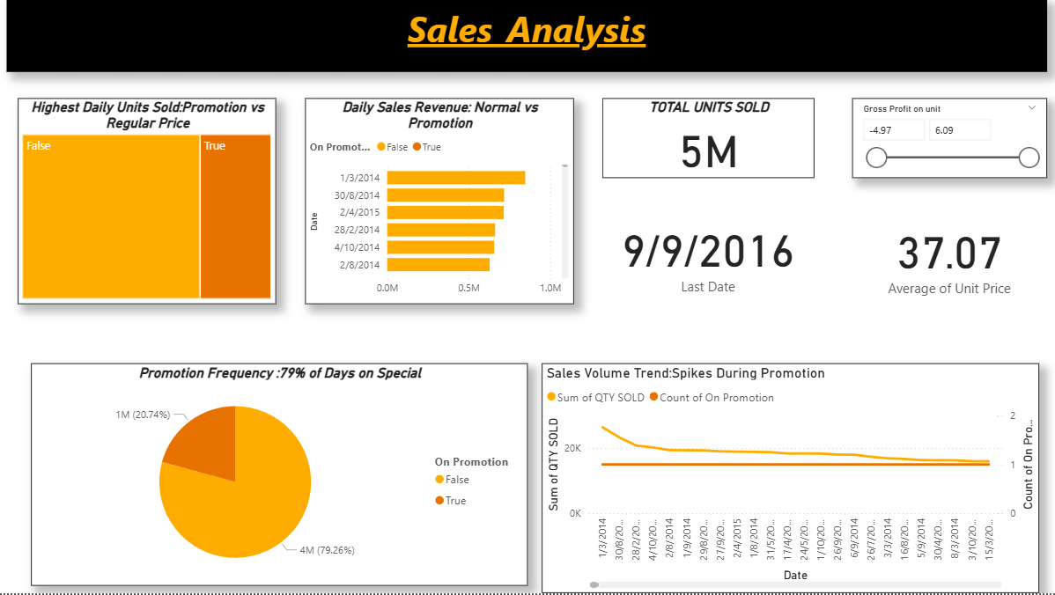
VISUALISATIONS
1.Daily sales Revenue -Normal vs Promotion Days
2.Highest Daily Units sold –promotion vs regular
3.promotion Freqency
4.sales volume trend- spikes during promotions
5.total units sold

Slide 6
Key insights & recommendations
Insight | Evidence | Recommendation
Promotions boost volume | +41.8% units sold | Use for inventory clearance
Margins collapse | -2.1% vs +29.4% | Limit to < 30% of days
High elasticity | PED~-1.8 | Small price cuts =big volume
Over- discounting | 57.7% promo days | Shift to targeted weekends

Slide 7

Thank you

